Slide 1
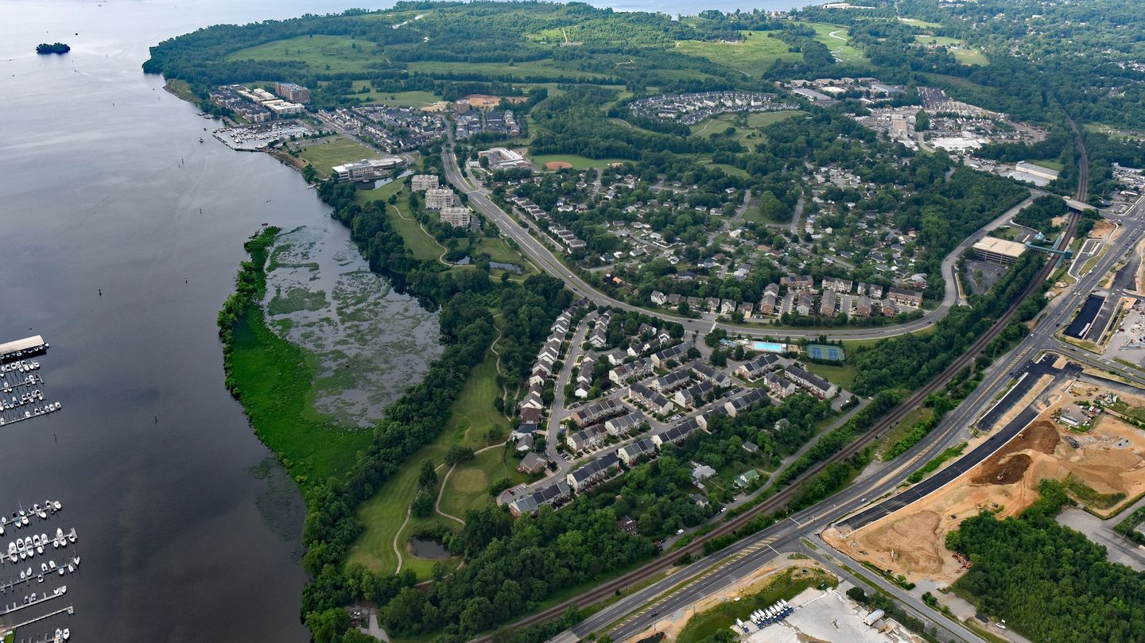
Concerned Citizens United for Belmont Bay
Belmont Bay Environmental Forum
8-06-23

Slide 2
Potomac River Refuge Complex Mason Neck, Occoquan Bay and Featherstone

Slide 3
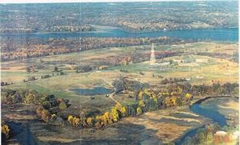
Harry Diamond Labs View - DOD

Slide 4
Current Development Plan

Slide 5
New Rezoning Plan

Slide 6
Current Opposition
Northern Virginia Audubon Society
Letter sent to PWC Supervisors and Planning Commissioners
Belmont Bay Concerned Citizens
Testimony and Letters to the PWC Supervisors and Planning Commission
Petitions signed by a majority of the Community
Belmont Bay Homeowners Association
Concerned Citizens United for Belmont Bay
Riverbend Estates
Letters and petitions signed by dozens of residents
Prince William County Conservation Alliance
Letter Sent to PWC Supervisors and Planning Commission
Prince William County School Board
Opposition included in PWC Staff Analysis

Slide 7
Trust Issues Two HOAs Past Promises Never Kept Golf Course and Open Space Recent Bulldozing of Wetlands Incursion into Golf Course Dumping without Permits and Misrepresentation of our HOA by the Developers

Slide 8
Key Environmental Issues Raised by the Opposition
County Staff Report
1) Double Counts Existing open space for the 30% requirement
2) Development will be “underserved” in open space and recreation
3) No dedication of open space land until 1,100 homes built
4) Setbacks are too minimal and need to be increased
NWR wants 300 ft. and Audubon at least 100 ft.
Fairfax County – Impervious area %; Density; Living shoreline; more parks, archeological survey
Prince William Parks – 3 pages of concerns
PW Transportation – 20 pages
PW Watershed – Fix RPAs; Forest Clearing; Wetland degradation; stormwater

Slide 9
What You Can Do
Call Your Supervisors Office to Object
Any development should not change the neighborhoods character
Minimize development near the Refuge and provide 100 foot setbacks
Minimize density to better control runoff into the Occoquan and Refuge
Decrease the Density significantly
Call your Planning Commissioner with the Same Message
Tell your neighbors about the negative impact
Tell other elected officials of your opposition

Slide 10
www.belmontbayunited.com Rob Hartwell – 571-212-2129
Board Chairman Ann Wheeler
chair@pwcgov.org
703-792-4640
Woodbridge Supervisor Margaret Franklin
mfranklin@pwcgov.org
703-792-4646
Woodbridge Planning Commissioner and Chairman Cynthia Moses-Nedd
planningwoodbridge@gmail.com
703-973-0161
Prince William Planning Office
planning@pwcva.gov
703) 792-7615 (TTY: 711)
PWC Zoning Ordinance
https://library.municode.com/va/prince_william_county/codes/code_of_ordinances?nodeId=CH32ZO
Comprehensive Plan and Maps
https://www.pwcva.gov/department/planning-office/prince-william-county-comprehensive-plan

