Slide 1
Bats Detected on Occoquan Bay National Wildlife Refuge
Presented by Gabby Youngken, Visitor Services Specialist
Notes:
Put logo

Slide 2
Table of contents
01
02
03
04
About the Refuge
Survey
Results
Conclusion

Slide 3
U.S. Fish and Wildlife Service
Mission
Working with others to conserve, protect, and enhance fish, wildlife, plants and their habitats for the continuing benefit of the American people.
Notes:
Put picture

Slide 4
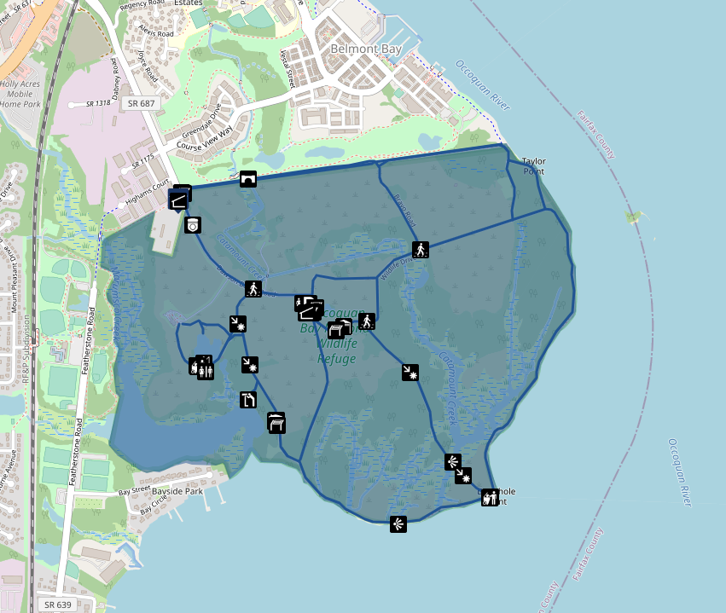
Occoquan Bay NWR
Created in 1998
Goal: Protect and conserve habitat for migratory birds

Slide 5
Bat Survey
Question: What bats are on the refuge?
Notes:
So now let’s get into what you’re actually here for. The bats.
In 2017 we wanted to find out what kinds of bats are on the refuge.

Slide 6
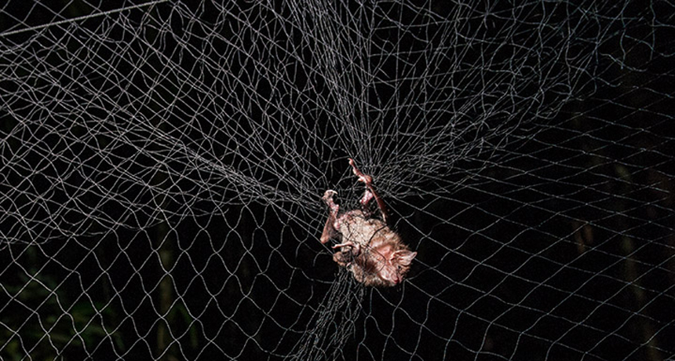
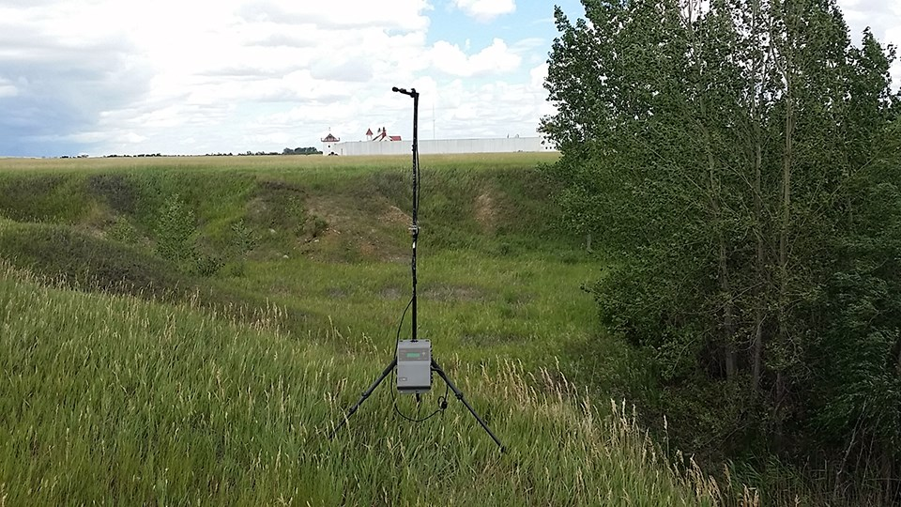
Method: how to determine what bats are out there
Mist Netting
Acoustic Recording
Catching bats in nets
Recording the sounds of bats
Photos from Google
Notes:
So how do we determine what bats are out there? Well, there are 2 methods that we looked into. The first is mist netting. This method requires bats to fly into these nets and then biologists will remove them and taken any data they need (weight, hight, species etc.)
The second option is acoustic recording which requires a microphone to be put out in the field and when bats make a call or a noise, the microphone will record it and store all the calls. Eventually, someone will need to go out and collect the SD cards that hold the recordings and analyze the calls to determine which bats were recorded.
Pros and cons to both methods.
Mist Netting: Need to be in person but you get accurate results. Need a rabies shot.
Acoustic Recording: Don’t need to be in person, might not record everything. Can’t measure population
We wanted something simple so they chose to do acoustic recording to find what bats are around the refuge.

Slide 7
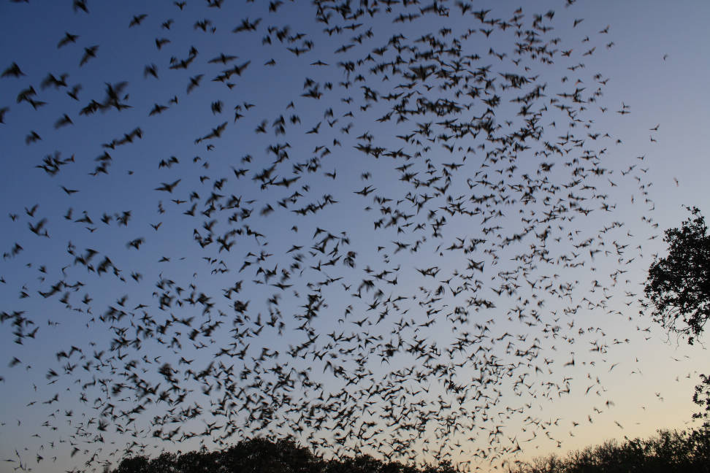
Method
Put 3 microphones in 3 different locations around the refuge (1 microphone/location)
The microphones were out for 3 nights in each season
3 Seasons
Maternity (May-July)
Volant (July-August)
Migratory (September-October)
Ann Froschauer/USFWS: Bats in Mexico

Slide 8
Results
We have bats!!
Notes:
So what were the results of the survey?

Slide 9
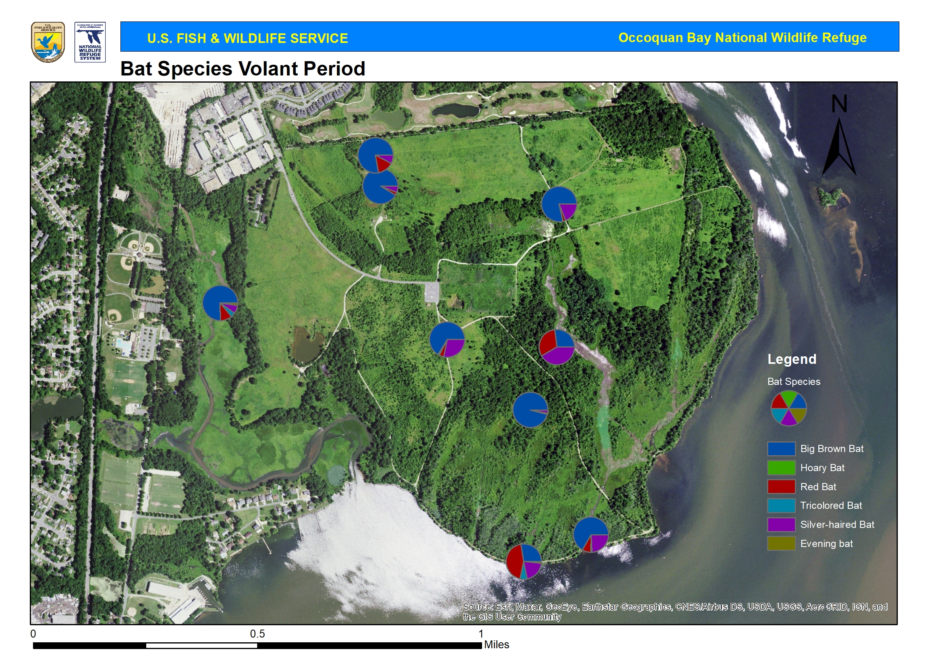
Results
Map made by Chris Wicker/USFWS
Notes:
Replace grid map with map without grids
The bats that were detected does not mean they live on the refuge. They could just be flying in the area.

Slide 10
Conclusion
Most common
Population
Future plans
Big Brown Bats and Silver-Hair Bats were the most common in each location
This method does not measure population. Only tells us what bats were around at the time
No future plans to do another survey
Notes:
Future plans: No future plans to re-do the survey. We just wanted a baseline of what bats were on the refuge.

Slide 11
Thanks!
Do you have any questions?
gabriela_youngken@fws.gov
703-490-4979 ext. 58525
https://www.fws.gov/refuge/occoquan-bay

Slide 12
Icon pack

