Slide 1
The Endangered Species Act Helped Save Mason Neck
By Rob Hartwell
The 2023 Bat Festival
November 2, 2023

Slide 2
Mason Neck’s Unique Attributes
The History
  Captain John Smith, George Mason, George Washington, Pohick Church and her native populations (Dogue – Tauxenent)
The Environment
  The habitat and fisheries
  The Bald Eagles
  The quality of life so close to Washington

Slide 3
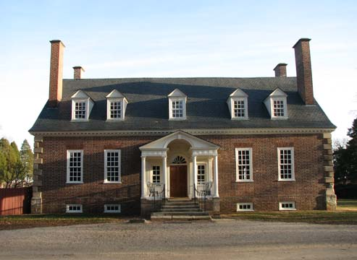
Mason Neck’s Legacy

Slide 4
The Land
9,500 acres
6,437 acres preserved
It all began with Gunston Hall
Lexington
Lewis Chapel (Cranford Church) and Pohick Church
Accotink Creek, Pohick Creek, Giles Run, Massie Creek, Thompsons Creek and Kanes Creek
The Great Marsh

Slide 5
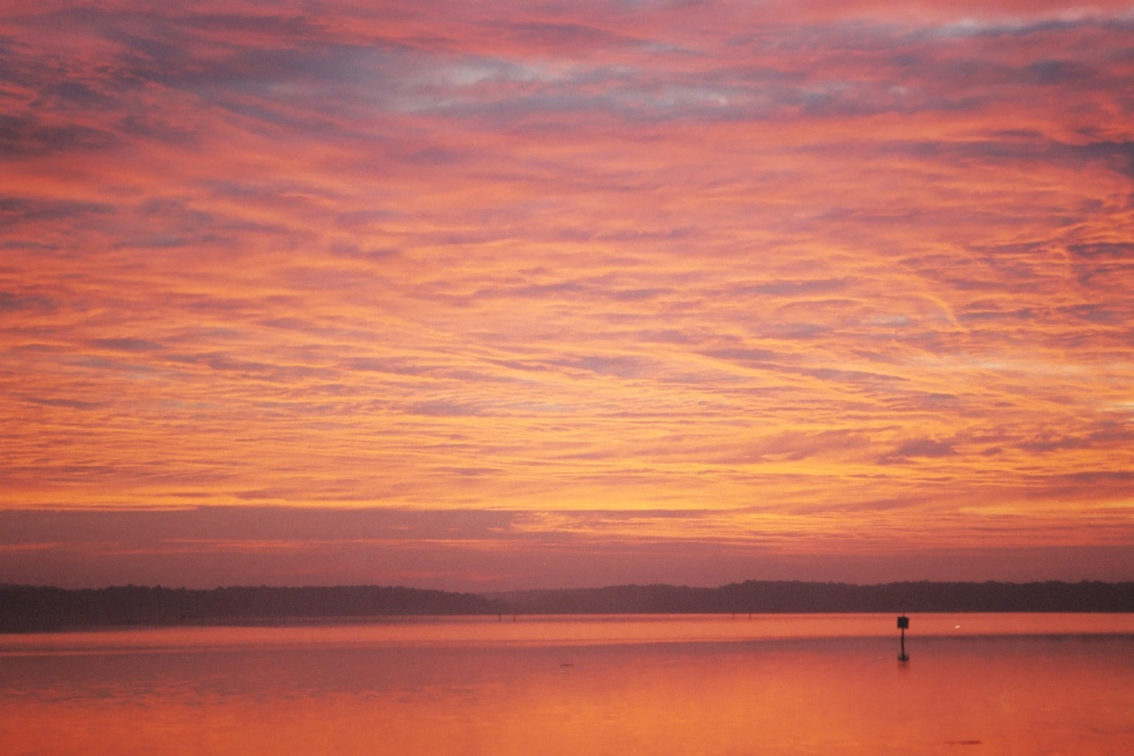
Belmont Bay

Slide 6
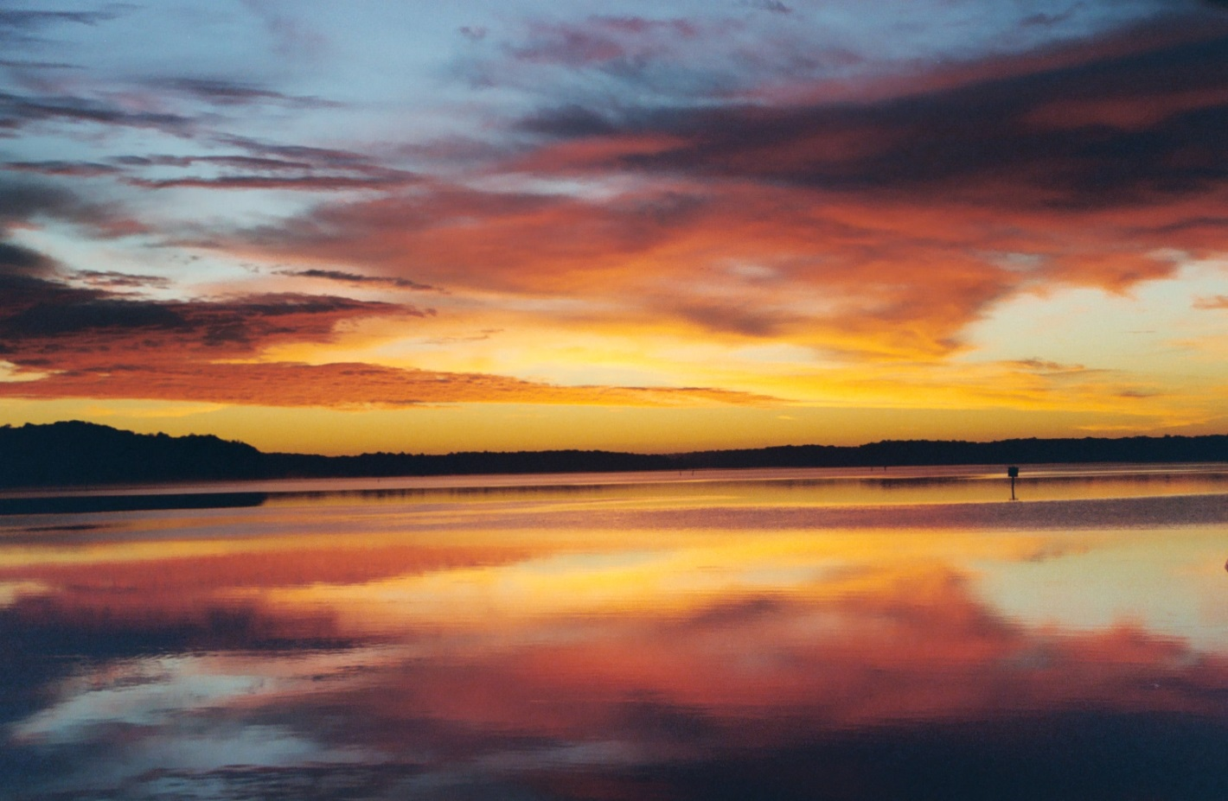
Mirror Sunrise

Slide 7
The Preservation Effort
In 1949 the Boy Scouts purchased 160 acres at what is now known as Camp Wilson
In 1940s and 1950s Gunston Manor and Hallowing Point were first subdivided
In the 1960’s the environmental movement began
In 1960, Elizabeth S. Hartwell moved to Hallowing Point and joined the Garden Club
In 1963 an accidental DDT use changed her life

Slide 8
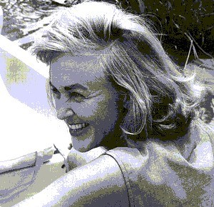
Elizabeth Speer Hartwell (Liz)
(Dec. 1,1925 – Dec. 16, 2000)
Named Fairfax County’s 1971 Citizen of the Year;
Vice Chairman of the Northern Virginia Regional Park Authority;
Secretary and Vice President of the Conservation Council of Virginia;
Chairman of the Citizens Council for a Clean Potomac;
A Board Member of the Central Atlantic Audubon Naturalist Society;
Elected as a member of the Committee of 100 on the Federal City;
Appointed to the Fairfax County Sewer Committee;
The organizer of the Friends of Mason Neck;
Appointed by Gov. Linwood Holton to the State Board of Agriculture;
A Fairfax County Wetlands Board member and chairman for 7 years;
Appointed to the Northern Virginia Potomac River Basin Committee by Governors Charles Robb and Gerald Baliles;
Given the National Capital Area Garden Clubs Conservation Award;
Honored with the D.C. Soil and Water Conservation Society of America;
Recognized by the Virginia Department of Agriculture;
Awarded the Virginia Wildlife Federation’s Conservationist of the Year;
Recognized by the Virginia Isaac Walton League, the Fairfax County Board of Supervisors; and the Virginia Division of Parks and Recreation;
Awarded the Fairfax Park Authority’s 1990 Elly Doyle Service Award and,
Honored as the historic archaeological Tauxenent Indian site visited by Captain John Smith in 1608 was named the “Hartwell Site” by the Fairfax County Heritage Resources Branch.

Slide 9
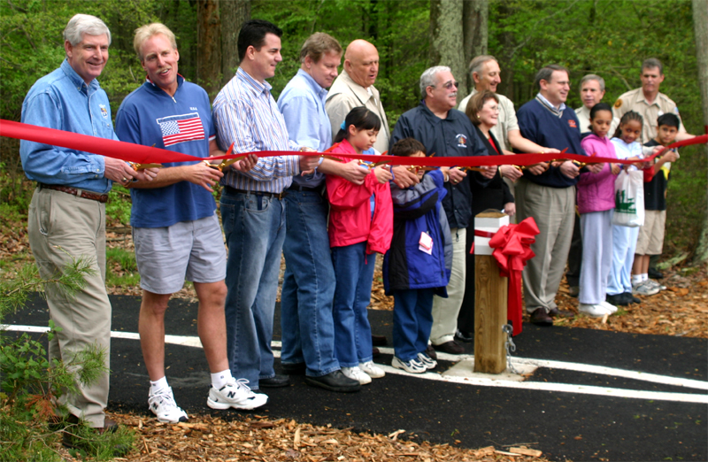
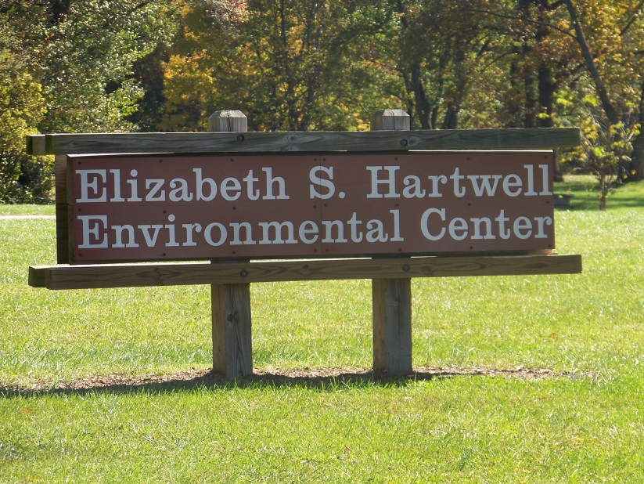
The Eagle Festival
Inaugurated April 21, 2001

Slide 10
The Early Days
DDT and Silent Spring
The last two Eagles nests
The Potomac’s “National Disgrace”
Lyndon and Lady Bird
  Interior Secretary Udall’s Report in 1966
Oil Spills and River fires led to federal action on clean water by President Nixon, establishment of the EPA, and Endangered Species Act

Slide 11
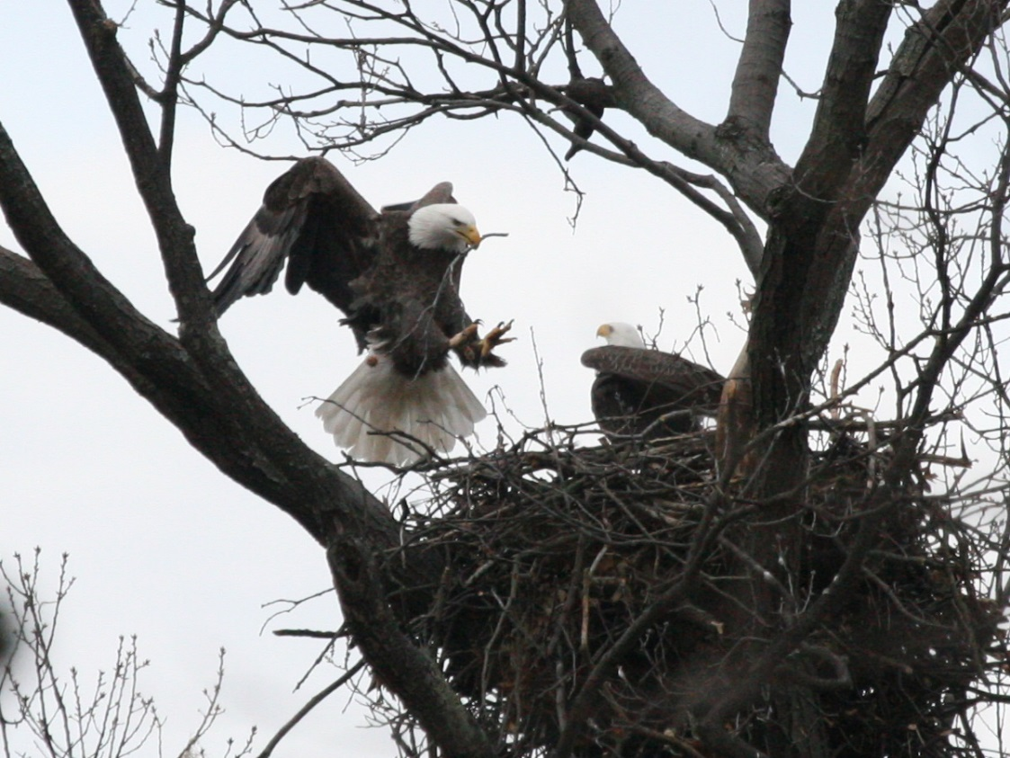
The Eagles Were Key
Photo Courtesy of Hank Meinecke

Slide 12
A Political Symbol
Endangered
Just one “active” nest left
Perhaps 50 Eagles roosting on the “Neck”
In 2006 (5 Eagles Nests in Refuge and State Park) Today many more
A thriving population even nesting in neighborhoods
Dozens in the Winter along with water
  Over 100 sighted one year at OBNWR

Slide 13
Northern Virginia Regional Park Authority’s First Action
1966 Report Called for Federal Acquisition but funds were not available
NVRPA purchased tract to hold for Nature Conservancy for future federal transfer
Walter Mess worked with Liz Hartwell and the Conservation Committee to Preserve Mason Neck, to make this happen
1967 Saw the State begin to purchase tracts for the future park
Nearly 20 Years later, April 1985, the Park Opened

Slide 14
The Early Battles
Wills & Van Metre
  Hull King -1800 acres
  Kings Landing to have a 500 Boat Slip Marina and 20,000 residents
  1964 saw Planning Commission Approval
State Water Control Board to Permit Sewage Treatment Plant in the Great Marsh
CCPMN with Interior got Board Postponement
1966 Bonds Passed
Nature Conservancy

Slide 15
This Battle Set the Stage
The Outer Beltway through Mason Neck and Belmont
Columbia Gas LNG
The Metro Landfill
Deep Sea Marina
Aerosol Testing
Lebanon
Smoot Sand & Gravel
Airport Expansion at Belvoir
Bajama (Conrad) Island
Infill via Sewerage Extension
500 Acre R&D Science Center
George Mason University Center
Gunston Hall Privatization

Slide 16
Liz’s Legacy
Elizabeth Hartwell Mason Neck National Wildlife Refuge (2,275)
Pohick Bay Regional Park (1,002)
BLM Meadowood Management Area (800)
Mason Neck State Park (1813)
  Featherstone NWR (325)
  Occoquan Bay NWR (644)
  Dyke Marsh (380)
  Huntley Meadows
  Cooperative Purchase Agreements
  Land Swaps

Slide 17
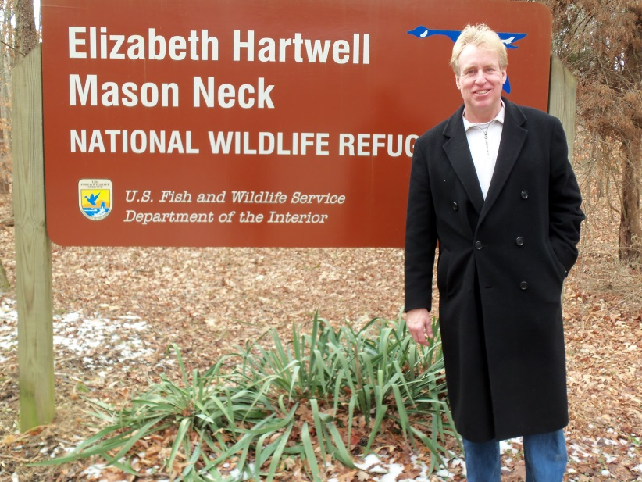
Elizabeth Hartwell Mason Neck National Wildlife Refuge
Mason Neck Citizens Association
Hallowing Point River Estates
Lorton Federation
Linwood Gorham
Hons. Tom Davis, Jim Moran, John Warner & George Allen

Slide 18
The Stories
The Whaler and Canoe Trips
  Breakdowns
Turtle Soup
Water Moccasins and Copperheads
The Otters
Lorton Prison
Moonshine
The Madame
10 Year Old’s Playing the Slots
Snake Excursions
Ducking for the Eagles in the Roost
The Eagle Lady

Slide 19
Some Other Key Early Players
The Coles
Joseph Flakne
Cindy Rufty
Marvin Miller
The Kniplings
Joyce Wilkinson
Lowell Curtis
Glenda Booth
Linwood Gorham
Mary Jane Reyes
The Meineckes
Hon. Jim Dillard
Hon. Clive Duvall
Hon. Jack Herrity
Hon. Jean Packard
Hon. Tom Davis
Hon. Farrell Egge
Hon. Audrey Moore
Hon. Gerry Hyland
Hon. Jim Moran
Hon. Dave Albo
Hon. Toddy Puller

Slide 20
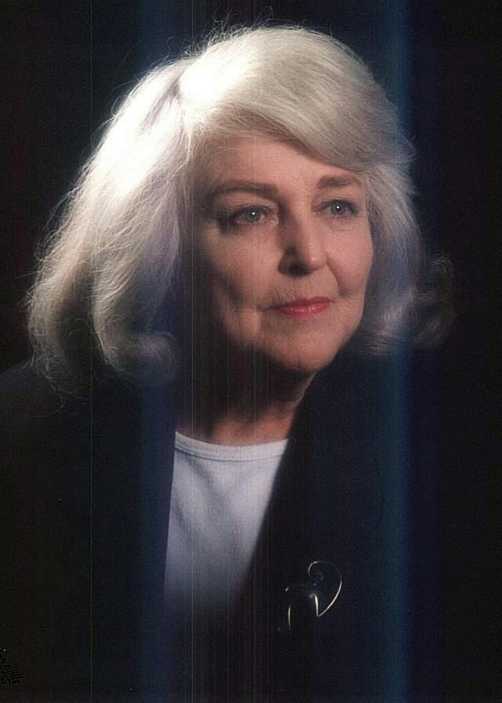
Thank You

